Slide 1

Frontend 106

Slide 2

Flex
Flex container
Flex elements
Домашнее задание
FRONTEND 104 – CSS PSEUDO

Slide 3
Технология Flex
https://medium.com/@stasonmars/%D0%B2%D0%B5%CC%88%D1%80%D1%81%D1%82%D0%BA%D0%B0-%D0%BD%D0%B0-flexbox-%D0%B2-css-%D0%BF%D0%BE%D0%BB%D0%BD%D1%8B%D0%B8%CC%86-%D1%81%D0%BF%D1%80%D0%B0%D0%B2%D0%BE%D1%87%D0%BD%D0%B8%D0%BA-e26662cf87e0
https://developer.mozilla.org/ru/docs/Learn/CSS/CSS_layout/Flexbox
display: flex;

Slide 4
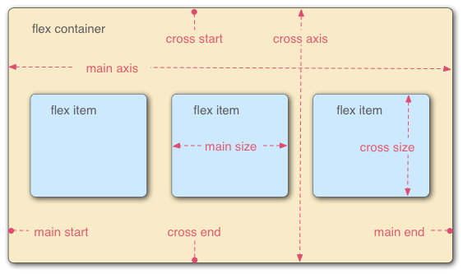
Расположение осей

Slide 5
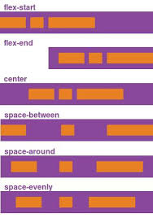
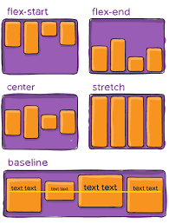
Позиционивароние

Slide 6
Свойства
Контейнер:
flex-direction
flex-wrap
flex-flow
justify-content
align-items
align-content
Элемент:
flex-grow
flex-shrink
flex-basis
flex
align-self

